Slide 1

Air Travellin’ USA
Project 3 - Team 6

Slide 2




As frequent travelers from NYC, we’d like to know more about the flight options available to us from the 3 major NYC airports.
Which of the NYC airports serve the most destinations? Which destinations are the busiest?
Of the 3 NYC airports, how many airlines serve each destination? Conversely, which airlines serve the most destinations?
Which airlines have the most delays and cancellations?

Slide 3
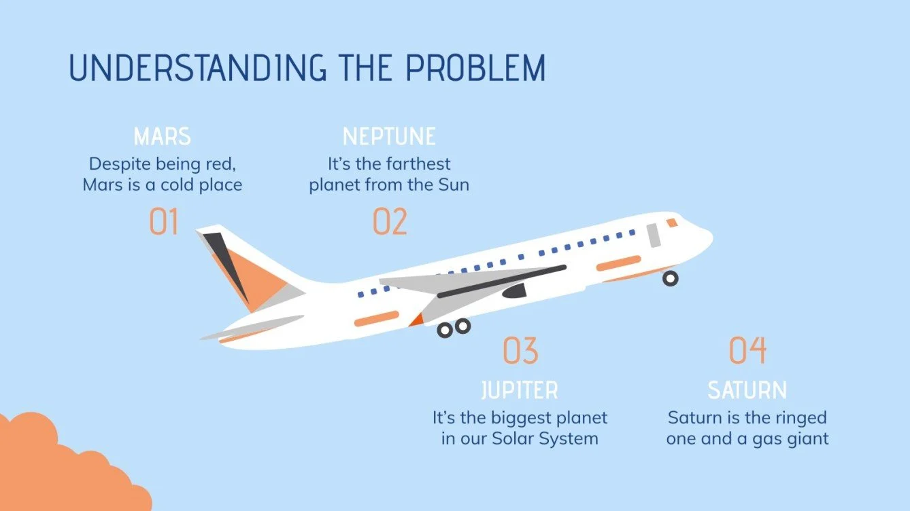
FLIGHT PATH: STEPS TAKEN
Load the Data
Clean the Data
Load the data into a SQL database
Get the Data
Clean the data in python, export to csv
Openflights.org
Jfkairport.com
etc
03
02
01
Show the Data
Build our visuals using Leaflet, Plotly, new Leaflet plugin (.curve)
Retrieve the Data
Host the Data
Using our API, retrieve the data in JavaScript
06
Build a Flask API
04
05

Slide 4

[INSERT MAP CURVE VIDEO - SAM]

Slide 5

[INSERT MAP MARKER VIDEO - TERRY]

Slide 6
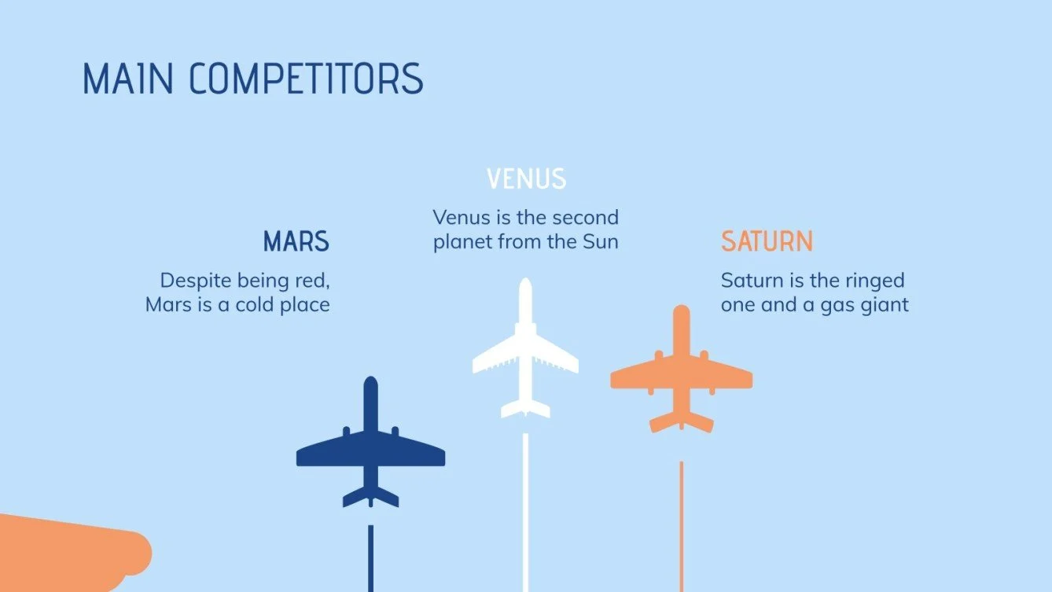
Based on the map, we can see that JFK has the highest volume of departing flights, meaning the most options for international travel are out of JFK.
JFK
EWR
John F Kennedy International Airport
LGA
Newark International Airport
LaGuardia Airport

Slide 7
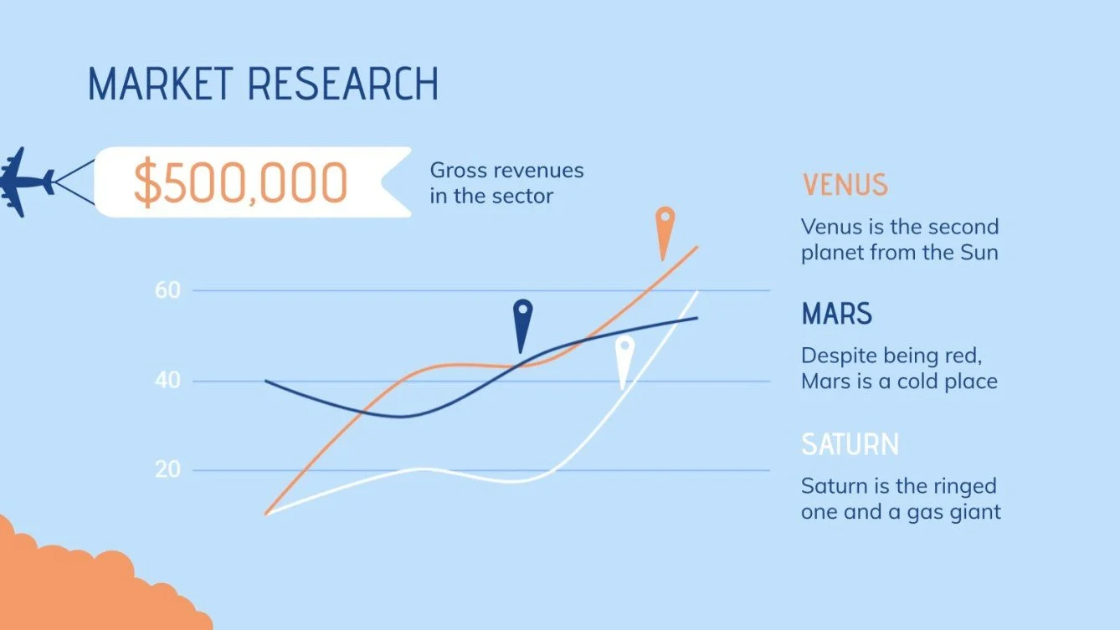
[INSERT BAR CHART/GLOBE VIDEO - KOMAL]

Slide 8

[Overall Video NIMRA]

Slide 9

[INSERT WEB SCRAPED PIE CHART VISUALS VIDEO - NIMRA]

Slide 10


THANK YOU!
QUESTIONS?

